Slide 1

Little Wandle Parent Workshop
Presentation 13.9.23

Slide 2
Our Phonics and Reading Rational
We want all children to be able to become fluent, confident readers and writers so that they develop a love of reading and writing as they move through their years at school.
All schools must follow a systematic synthetic programme for the teaching of phonics and early reading, we chose Little Wandle Letters and Sounds and started their programme last year. This has been accredited by the Department for Education.
We want to ensure, as a school, we are following a consistent approach which integrates research about the science of learning.

Slide 3
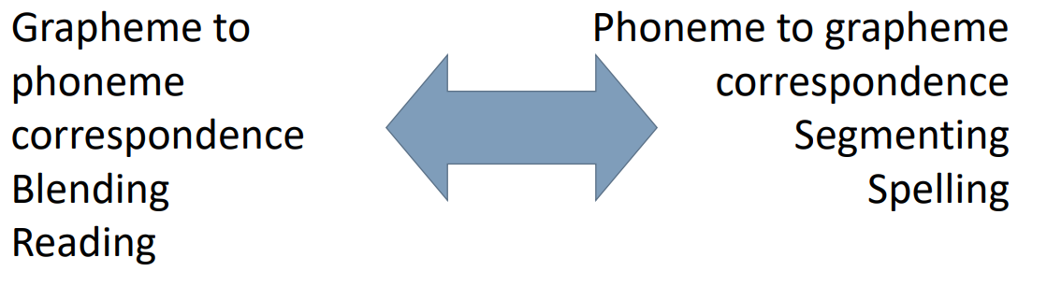
What is phonics?
Phonics is simply the code that turns written language into spoken language and vice versa.

Slide 4

Key words: phoneme and grapheme
The smallest unit of sound that can be identified in words. We use the term ‘phoneme’ but also call it a ‘sound’.
A grapheme is a letter or group of letters used to represent a particular phoneme when writing. This could be called ‘a sound written down’. The way graphemes are used to represent phonemes in our written language is known as the ‘alphabetic code’.

Slide 5
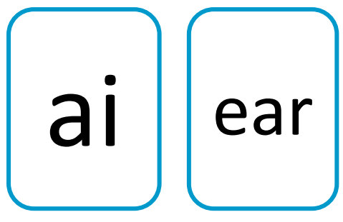
Key words: digraph and trigraph
A digraph is a grapheme using two letters to represent one phoneme. With children, we frequently reinforce it with the mantra ‘two letters, one sound’.
A trigraph is a grapheme using three letters to represent one phoneme. With children, we frequently reinforce it with the mantra ‘three letters, one sound’.

Slide 6
Knowing the GPCs
Little Wandle have helpful videos to ensure you know how to say the sounds the children are learning.
https://www.littlewandlelettersandsounds.org.uk/resources/for-parents/

Slide 7
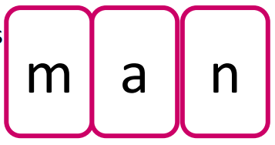
Blending
When we blend, we combine individual phonemes into a whole word, working all the way through from left to right.
Once the GPCs involved have been learned, blending is the key process involved in reading words effectively. It is a skill that needs lots of practise.
We practise by blending orally e.g., b-a-t, bat and then by using our GPCs.
Blending sounds into a word is not just saying them more quickly, nor of mixing them together like paint.
We join the phonemes into one continuous stream of sound to make a spoken word.

Slide 8
How we teach blending
https://www.littlewandlelettersandsounds.org.uk/resources/for-parents/

Slide 9

Tricky Words
Almost all words can be worked out using our alphabetic code. There are sometimes words with GPCs that we haven’t learnt yet that we see often in our books.
We show the children which part of the word is the tricky part.
Eventually, most tricky words become decodable because we have learnt the GPC.

Slide 10
How we teach tricky words
https://www.littlewandlelettersandsounds.org.uk/resources/for-parents/
https://www.lydlynchinfants.co.uk/phonics/

Slide 11
Daily Phonics Lessons: What they look like
We teach phonics for around 30 minutes every day
Recap GPCs and teach new ones
Recap reading words containing these GPCs
Recap tricky words
Oral blending
Read and write sentences
Spelling
Each Friday we review the weeks learning to help the children become fluent readers.

Slide 12
Daily Phonics Lessons: Coverage
https://www.lydlynchinfants.co.uk/phonics/ for programme overview for Year R and 1

Slide 13
Year 2
Rapid catch up
Fluency
Bridge to Spelling

Slide 14
Keep Up
Any child who needs additional practice has Keep-up support, taught by a fully trained adult.
Keep-up lessons match the structure of class teaching, and use the same procedures, resources and mantras, but in smaller steps with more repetition, so that every child secures their learning.
Some Keep-up sessions will be more regular, focusing on specific needs such as blending. Others may just be additional practice of the GPC that was taught in the morning.

Slide 15
Reading Practice Sessions
We teach children to read through reading practice sessions three times a week. These:
are taught by a fully trained adult to small groups of children
use books matched to the children’s secure phonic knowledge following assessments of the children.
are monitored by the class teacher, who rotates and works with each group on a regular basis.
Each reading practice session has a clear focus, so that the demands of the session do not overload the children’s working memory. The reading practice sessions have been designed to focus on three key reading skills:
decoding: reading words by sounding out and blending (if needed)
prosody: teaching children to read with understanding and expression
comprehension: teaching children to understand the text.

Slide 16
Reading at Home
Although your child will be taught to read at school, you can have a huge impact on their reading journey by continuing their practice at home, helping them to become fluent, confident readers.
There are two types of reading book that your child will bring home:
• A reading practice book: This will be at the correct phonic stage for your child. They should be able to read this fluently and independently.
• A Share a Story library book: Your child will not be able to read this on their own. This book is for you both to read and enjoy together.

Slide 17
The Reading Practice Book
We need your support to help your child practise reading and develop prosody within a book they have already read at school.
The book will be matched to their phonic stage and be fully decodable.
If your child is reading it with little help, please don’t worry that it’s too easy – your child needs to develop fluency and confidence in reading. These books are there to celebrate your child’s wonderful reading!
When your child is reading, listen with interest and encourage, praise and enthusiastically acknowledge their achievements, no matter how small!
Your child will bring home their reading practice book every Friday to be returned the following Friday.

Slide 18
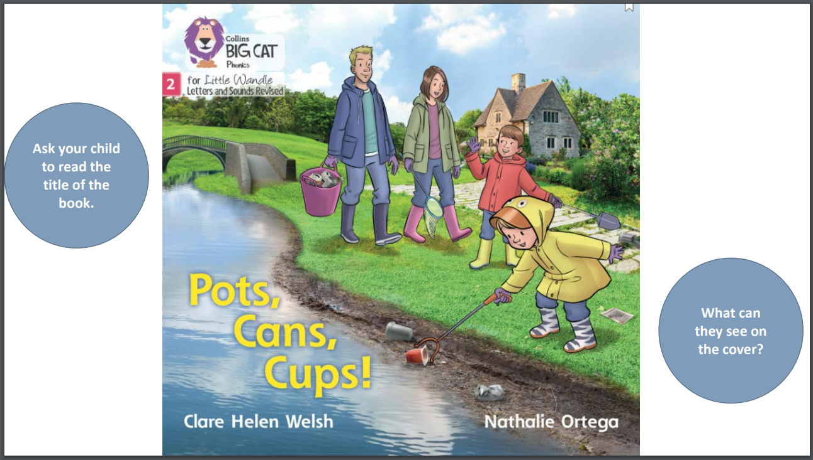

Slide 19
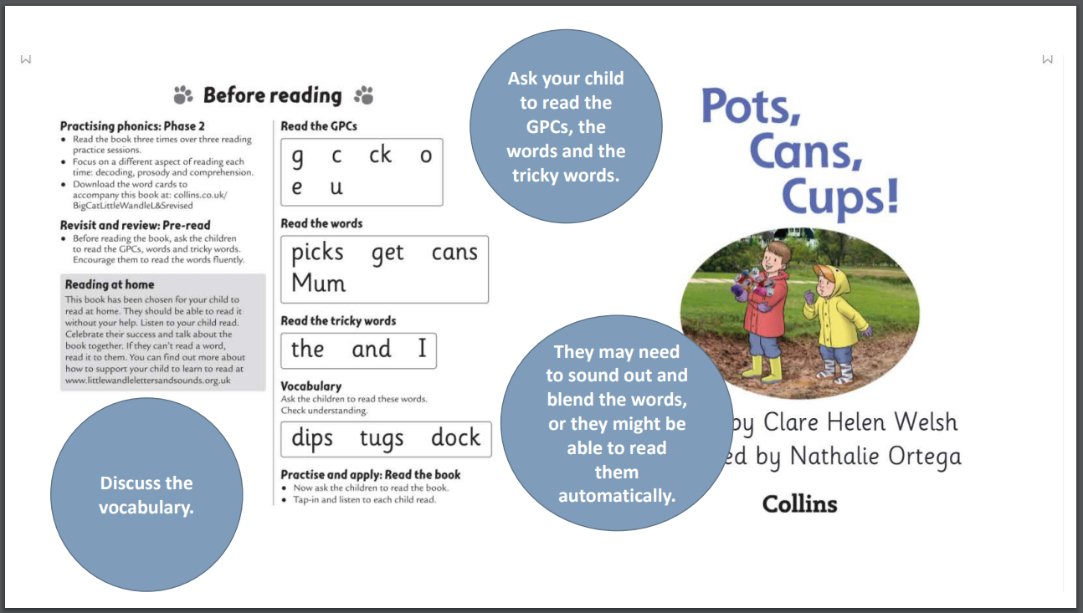

Slide 20
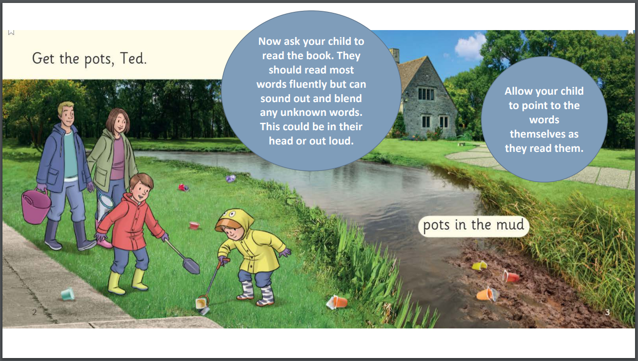

Slide 21
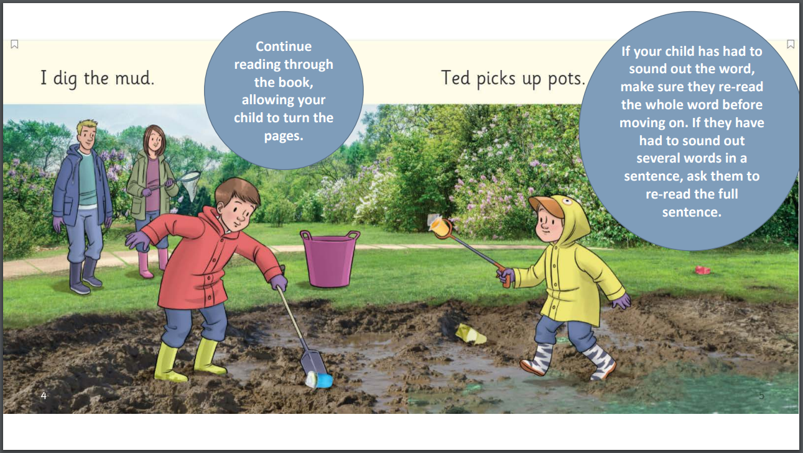

Slide 22
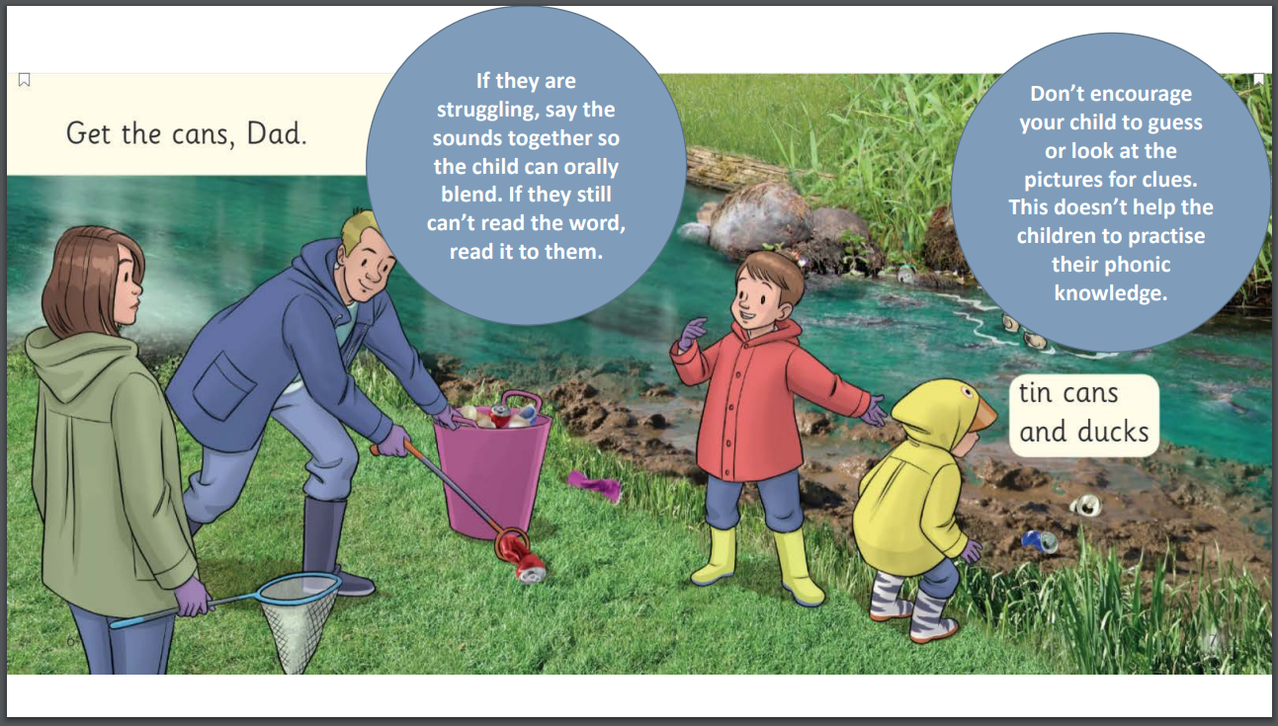

Slide 23
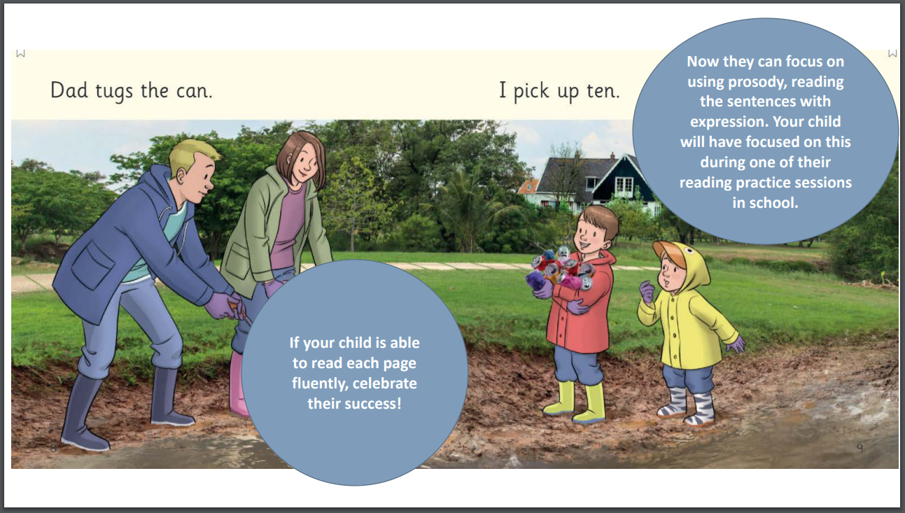

Slide 24
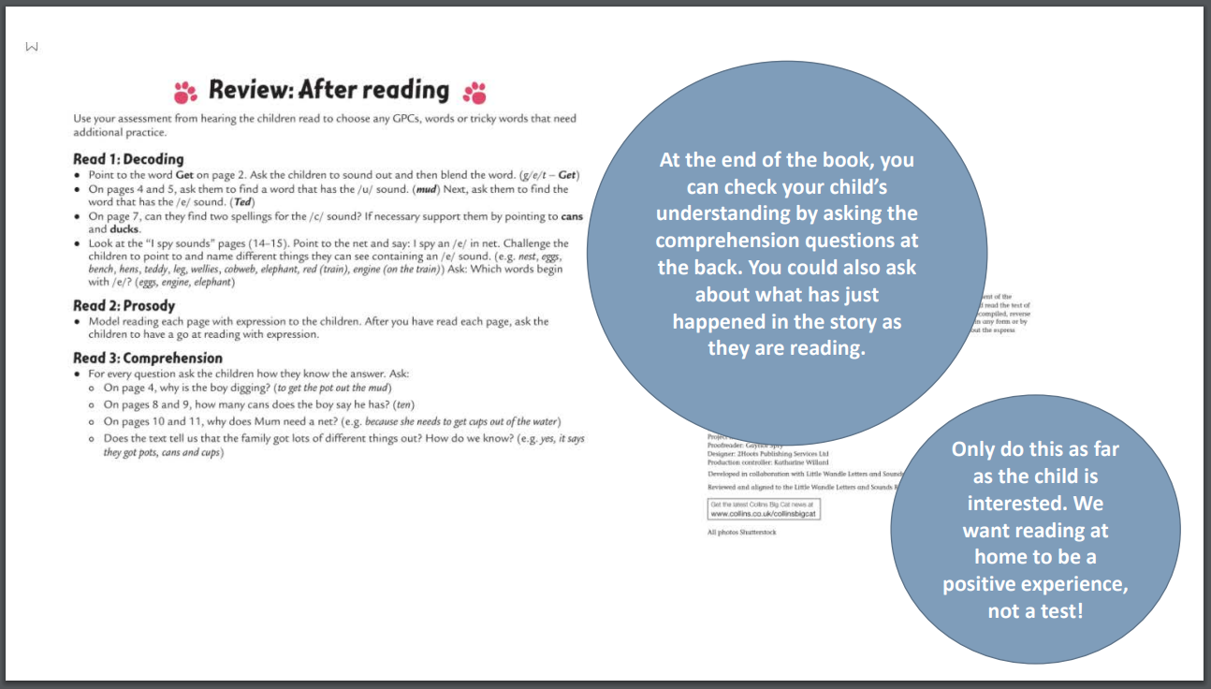

Slide 25
Tips for reading with your child checklist
• Before reading the book, look at the title of the book and discuss what they can see on the cover.
• Let your child turn the pages themselves so they are in charge of their reading.
• Ask your child to read the GPCs on the inside cover at the front of the book.
• Ask them to read the words on the inside cover by sounding out and blending.
• Ask your child to read the tricky words. Ask them to find the tricky bit before they say the word.
• Ask them to read the vocabulary words. Talk about the words and what they mean. It might help to show them pictures if they are unsure what the word represents.
• Now ask your child to read the book. They should read most words fluently but can sound out and blend any unknown words. This could be in their head or out loud. Allow your child to point to the words themselves as they read them.
• If your child has had to sound out the word, make sure they re-read the whole word before moving on. If they have had to sound out several words in a sentence, ask them to re-read the full sentence.
• If they are struggling, say the sounds together so the child can orally blend. If they still can’t read the word, read it to them. Don’t encourage your child to guess or look at the pictures for clues. Previously this was used as a strategy for working out an unknown word, but as this doesn’t help the children to practise their phonic knowledge, it can no longer be used.
• If your child can read each page fluently, celebrate their success! Now they can focus on using prosody, reading the sentences with expression. Your child will have focused on this during one of their reading practice sessions in school.
• At the end of the book, you can check your child’s understanding by asking the comprehension questions at the back. You could also ask about what has just happened in the story as they are reading. Only do this as far as the child is interested. We want reading at home to be a positive experience, not a test!

Slide 26
The Share a Story library book:
To encourage your child to become a lifelong reader, it is important that they learn to read for pleasure. The sharing book is a book they have chosen for you from our school library to enjoy together.
Please remember that you shouldn’t expect your child to read this alone. Read it to or with them. Discuss the pictures, enjoy the story, predict what might happen next, use different voices for the characters, explore the facts in a non-fiction book. The main thing is that you have fun!

Slide 27

Studies have shown…
Reading with your children builds warm and happy associations with books, increasing the likelihood that children will find reading enjoyable in the future.
Reading at home boosts school performance later on. It also increases vocabulary, raises self-esteem, builds good communication skills.

Slide 28
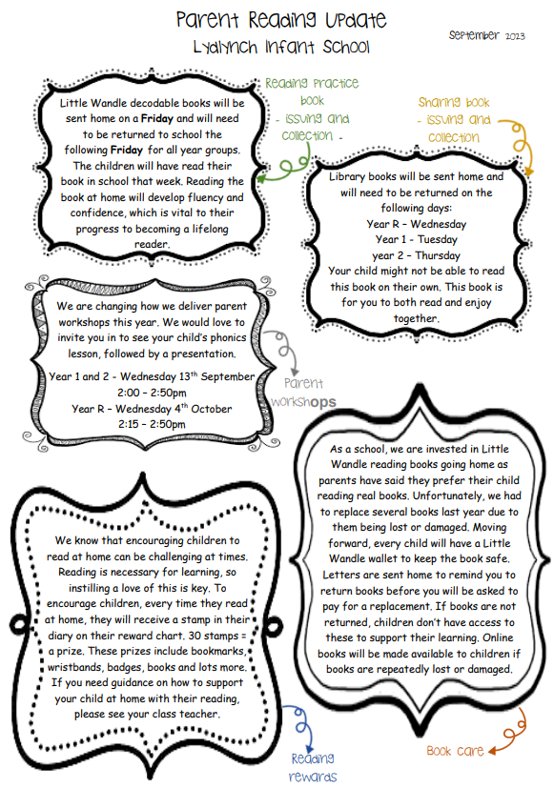
Parent Reading update

Slide 29
Thank you!
Any questions?

